Slide 1


Health Care Dialysis
Presented By : Group-1
Members: Anjali Kaushik Singh
Anupama Aditya Nagarkatti
Pranali
Santhosh Kavala
Shivani Reddy
Sarika Rajput
Sruthi Suresh

Slide 2


Contents:
Introduction
Health Care Overview
KPI 1
KPI 2
KPI 3
KPI 4
KPI 5
KPI 6
Dashboard
Conclusion

Slide 3

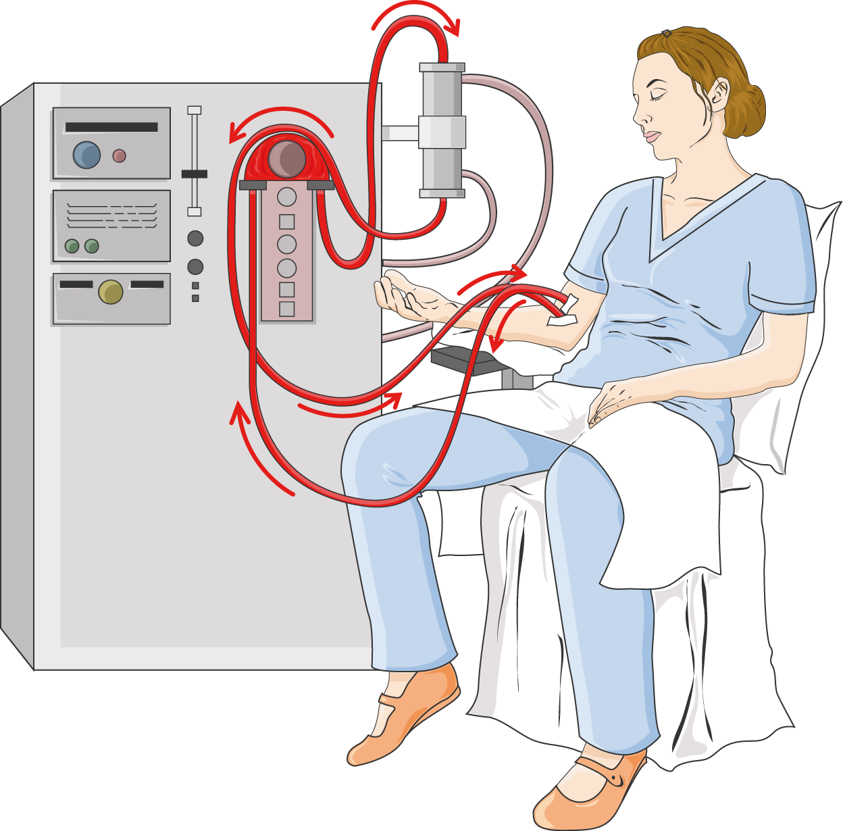
Introduction :
Dialysis is a crucial medical treatment designed to replicate some functions of the kidneys when they are no longer able to work effectively.
It is primarily used for patients with end-stage renal disease (ESRD) or severe chronic kidney disease (CKD).
Dialysis helps maintain the balance of the body's systems by removing waste products, excess fluids, and maintaining electrolyte levels.
The kidneys play a vital role in filtering blood, removing waste products, and balancing fluids and electrolytes.

Slide 4

Health Care Overview:
The Health Care Dialysis industry is a complex sector that operates globally, encompassing various treatment methods including hemodialysis and peritoneal dialysis.
It is a dynamic industry influenced by various factors, requiring adaptability, strategic planning, and a commitment to patient safety and satisfaction for long-term success.
Analyzing the data of the dialysis industry serves as a fundamental tool for improving efficiency and making informed decisions.
Data is analyzed in the form of relational, graphs, and document data models using tools like Excel, Tableau, Power BI, and SQL.

Slide 5
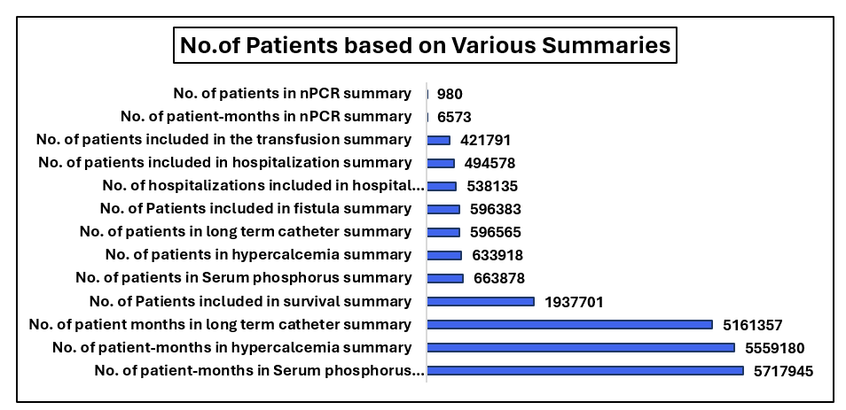
KPI-1 Number of Patients Based on Various Summaries
This KPI provides insights into the demand for dialysis services and assists healthcare providers in delivering personalized care.
It emphasizes the importance of prioritizing resources and interventions based on the frequency and health impact of each summary type.

Slide 6
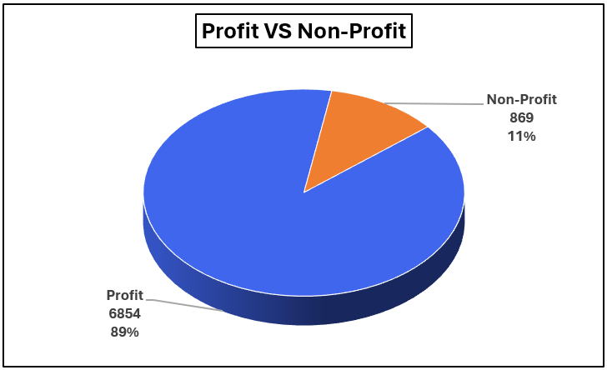
KPI-2 PROFIT V/S NON-PROFIT STATS
Comparing the financial performance is an important aspect which is required to understand the economic landscape of the health care sector.
This analysis helps in identifying the differences in financial outcomes between profit and non-profit organizations and enables the stakeholders to take informed decisions regarding resource allocation, cost management and sustainability of care.

Slide 7
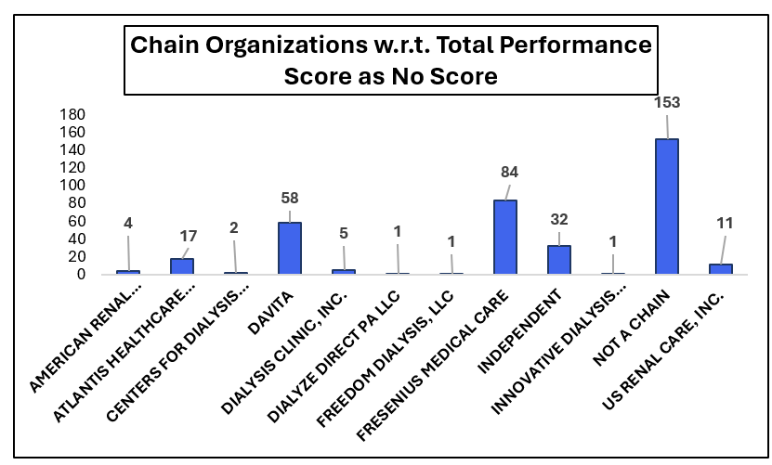
KPI-3 Chain Organizations w.r.t Total Performance Score as No Score
Assessing chain organizations based on the total performance score is a significant KPI in healthcare analytics.
By analyzing this KPI ,healthcare providers can identify the areas of improvement and provide quality care delivery across different chains.

Slide 8
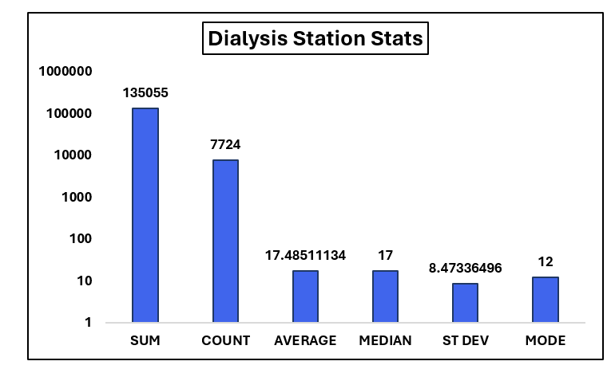
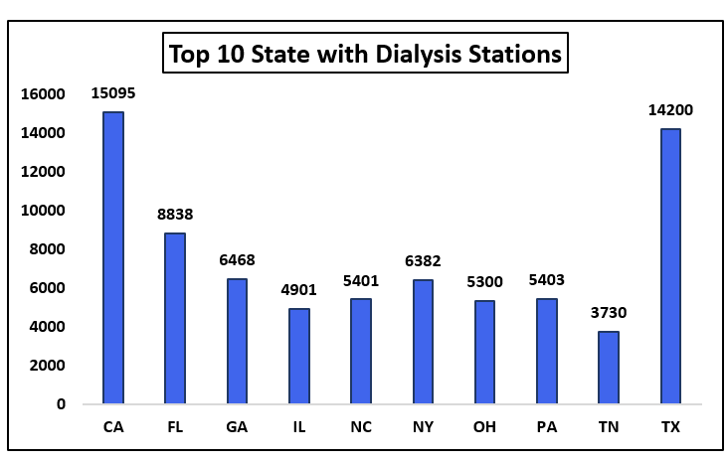
KPI-4 Dialysis Stations Stats
The number of dialysis stations varies considerably across the country. Some states, such as California, Texas, and Florida, have a large number of stations, while others, such as Wyoming, North Dakota, and Alaska, have relatively few. This variation is likely due to a number of factors, including population density, the prevalence of kidney disease, and the availability of healthcare resources.

Slide 9
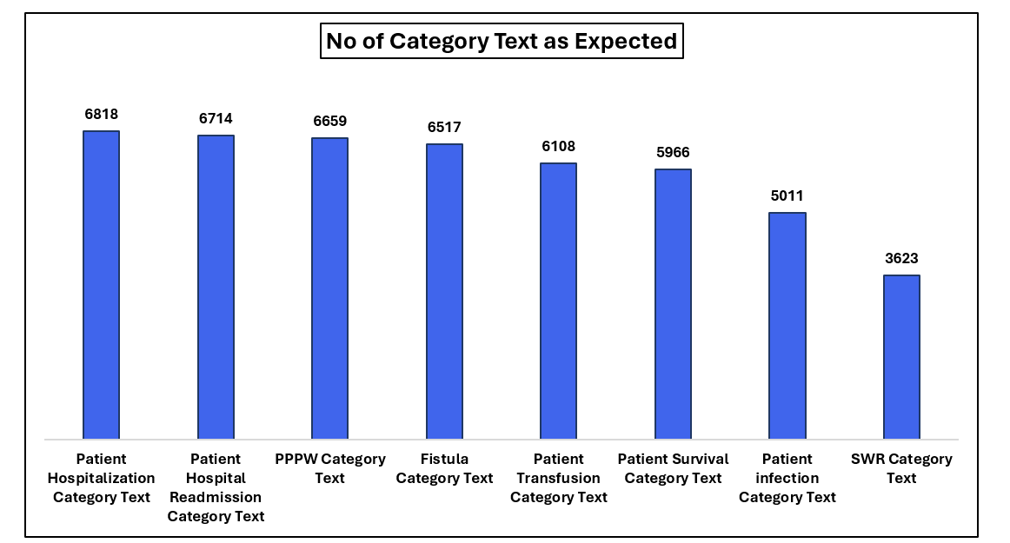
KPI-5# of Category Text - As Expected
“Hospitalization” category has the highest number of "As Expected" results (6,818), followed by "Hospital Readmission" (6,714) and “PPPW" (6,659). This suggests that these categories might be well-understood or predictable in terms of outcomes.

Slide 10
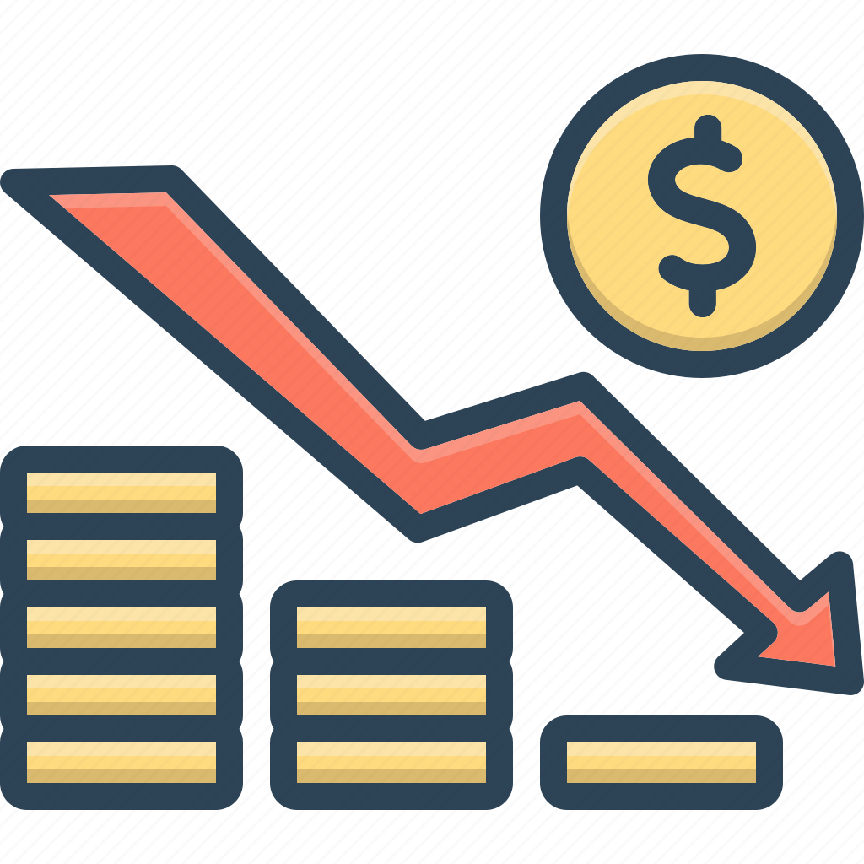
KPI-6 Average Payment Reduction Rate
Average Payment Reduction Rate Calculates and tracks the average rate at which payments are reduced, providing insights into cost-saving measures.
The average payment reduction rate was 0.32%.

Slide 11
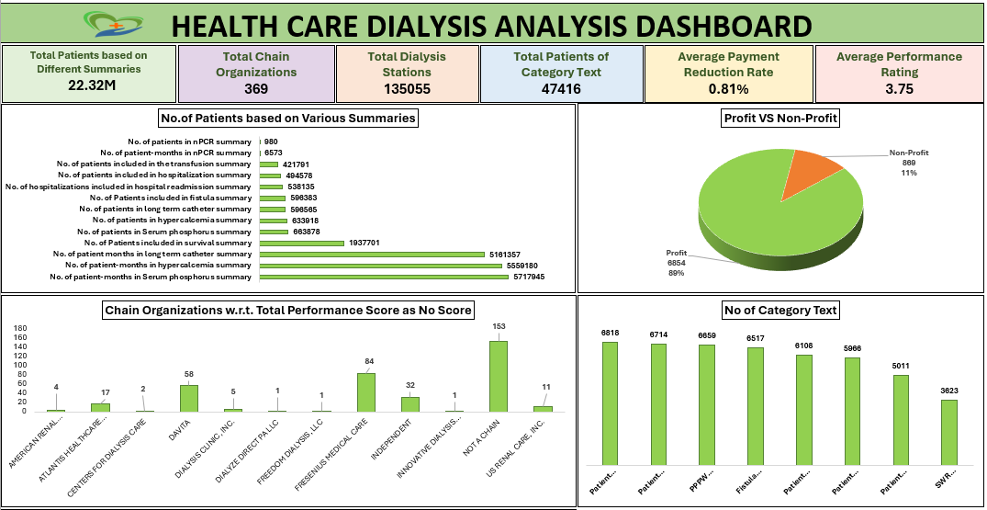

Slide 12
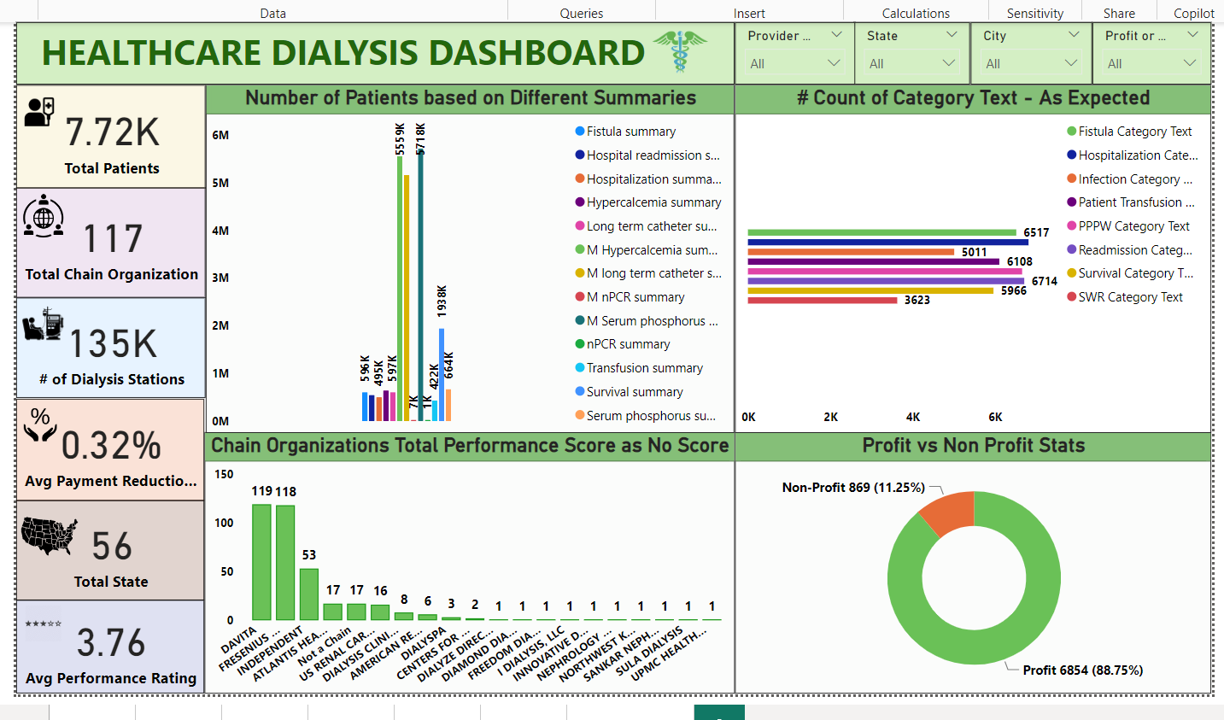

Slide 13
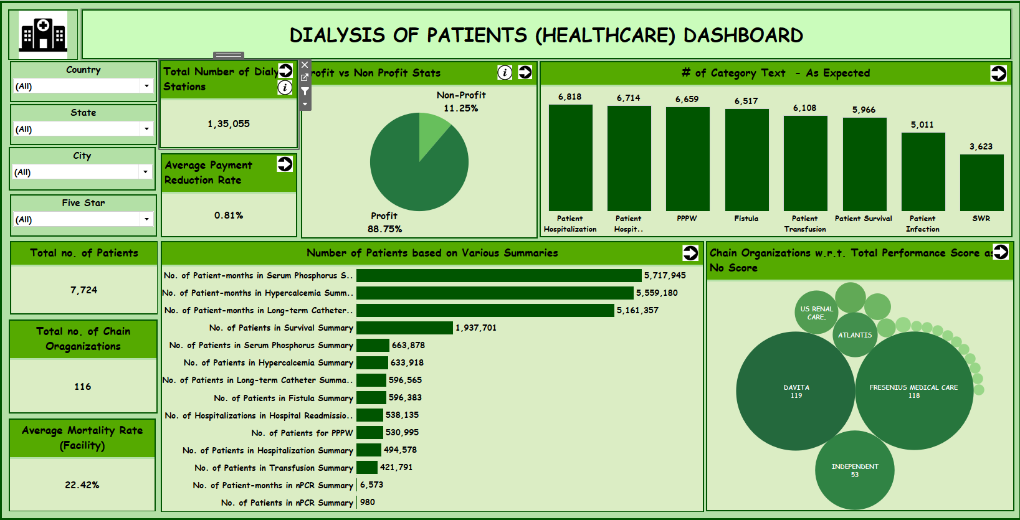

Slide 14
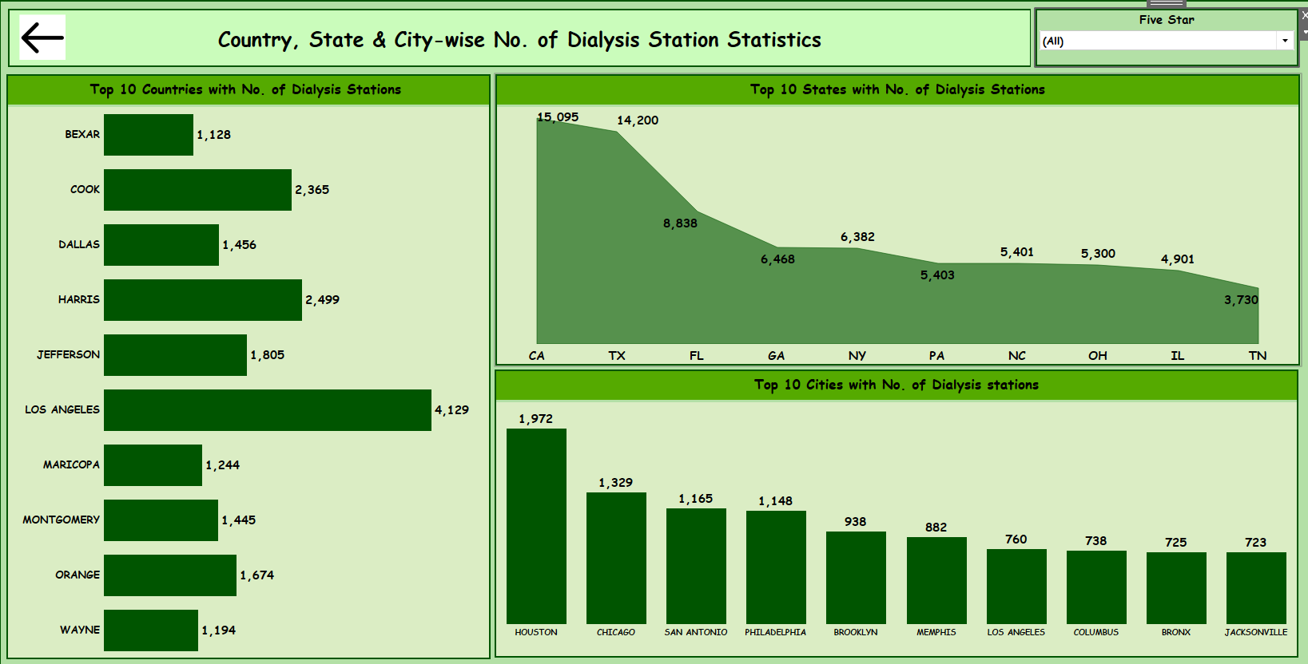

Slide 15

Conclusion :
The total number of patients across various summaries amounted to 22.32 million.
The "Serum Phosphorus Summary" has the highest number of patient-months.
There are 369 chain organizations with total performance score as no score.
The total number of dialysis stations is 135,000. California has the highest number of stations among the states, with 15,095 stations, while Houston leads among cities with 1,972 stations.
The overall profit reached 89%, with Los Angeles making the highest contribution.

Slide 16
THANK YOU

